Slide 1

School of Computer Science and Engineering
Department of Computer Engineering and Technology (DCET)
Full Stack Development Project Panel-A
PRN: 1032232774 Name: Kumar Ujjawal PRN: 1032233029 Name: Shrutee Iyer
PRN: 1032232889 Name: Taha Mohammedi PRN: 1032232956 Name: Sanya Asati

Slide 2
Problem Statement & Proposed Solution
Problem Statement
Many SMEs and freelancers still rely on manual invoicing, resulting in errors, delays, and limited financial visibility. Existing tools like Tally ERP and QuickBooks, though efficient, are expensive, complex, and unsuitable for small-scale users. Additionally, traditional systems lack real-time dashboards and centralized tracking, leading to redundant data entry and difficulty monitoring unpaid invoices. This project proposes a cost-effective, user-friendly web-based Invoice Management System that automates billing, ensures data accuracy, and provides real-time financial insights..
Proposed Solution
The proposed solution is a full-stack Invoice Management System using React.js, Flask, and MongoDB to automate billing and financial tracking for SMEs and freelancers. It offers secure login, CRUD operations for customers, products, and invoices, and a real-time dashboard for revenue and payments. This web-based platform replaces manual invoicing, improving accuracy, efficiency, and financial visibility while remaining cost-effective and scalable for future integrations..

Slide 3
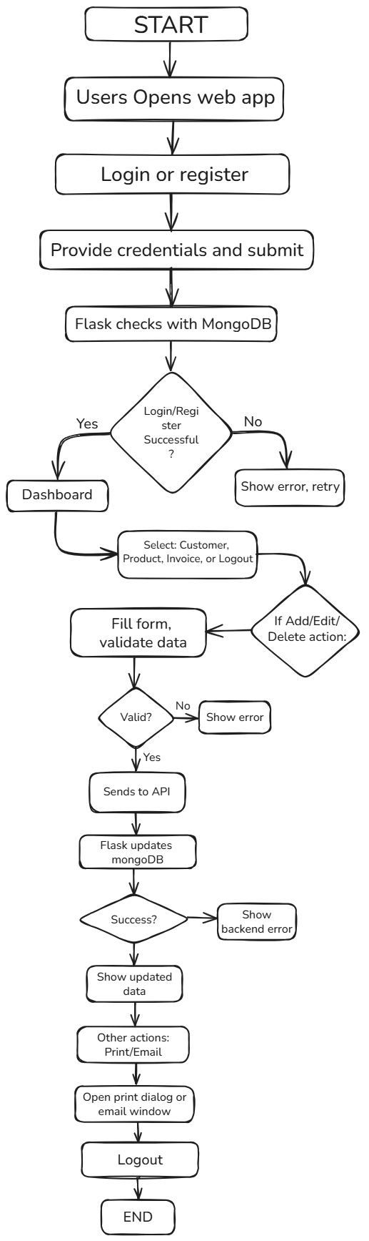
Process Flow Diagram & System Architecture
Step 1: User opens the web application.
Step 2: Login or register on the platform.
Step 3: Enter credentials and submit.
Step 4: Flask verifies credentials with MongoDB.
Step 5: If login/register fails → show error and retry.
Step 6: If successful → redirect to dashboard.
Step 7: User selects an action: Customer, Product, Invoice, or Logout.
Step 8: For Add/Edit/Delete → fill and validate the form.
Step 9: If valid → send data to Flask API.
Step 10: Flask updates MongoDB and returns response.
Step 11: Show updated data or backend error.
Step 12: Optionally print/email invoice, then logout to end session.

Slide 4
Technical Stack with Reasoning
Frontend:
Built using React.js for a fast and dynamic user interface
Styled with Bootstrap and CSS3 for responsive design
Uses React Hooks for managing component states
Backend:
Developed using Flask (Python framework)
Handles RESTful APIs, authentication, and data processing
Connected with MongoDB for data storage and retrieval
Database:
MongoDB stores customer, product, and invoice information
Provides scalability and quick access to records
Tools & Design:
VS Code → Development and debugging
GitHub → Version control and collaboration
Postman → API Testing

Slide 5
Challenges Faced during development if Any
Challenges Faced:
These challenges were resolved through iterative testing, clear communication between frontend and backend, implementation of validation and error handling, and adopting agile development with regular feedback cycles.
Ensuring smooth communication between frontend (React) and backend (Flask) with proper CORS setup.
Debugging 404 errors or failed API requests due to incorrect endpoints or server configuration.
Managing complex state and asynchronous data flow in React components.
Handling form validation and error messages across login, customer, product, and invoice pages.
Implementing secure user authentication and protecting API routes in Flask.
Structuring and optimizing MongoDB queries for reliable data management.
Integrating dynamic styling and layout with Bootstrap and custom CSS.
Addressing deployment issues, environment configuration (using .env), and cross-platform compatibility.

Slide 6
Limitation and scope of the project with future projection extension
Limitations
Limited scalability may arise with increasing data volume in MongoDB without further optimization.
Basic authentication and session management might need enhancement for stronger security.
UI design relies heavily on Bootstrap, which could limit customization flexibility.
Deployment and environment-specific configurations could be better automated for smoother production rollout.
Future Scope
Implement advanced role-based access control for enhanced security.
Integrate real-time notifications and alerts using WebSockets.
Optimize database performance with indexing and caching strategies.
Develop mobile-responsive UI or a dedicated mobile app for better accessibility.

Slide 7
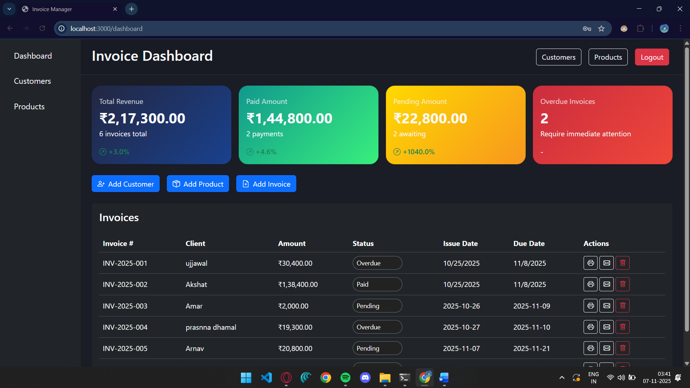
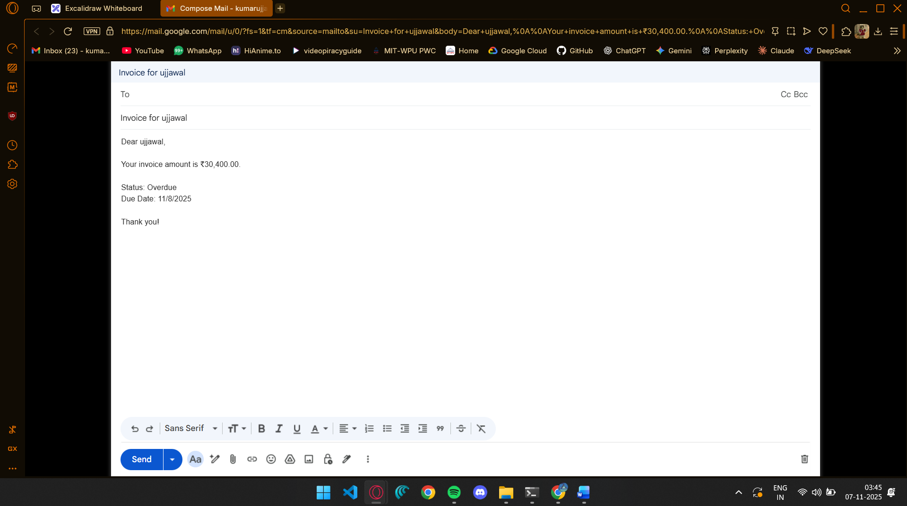
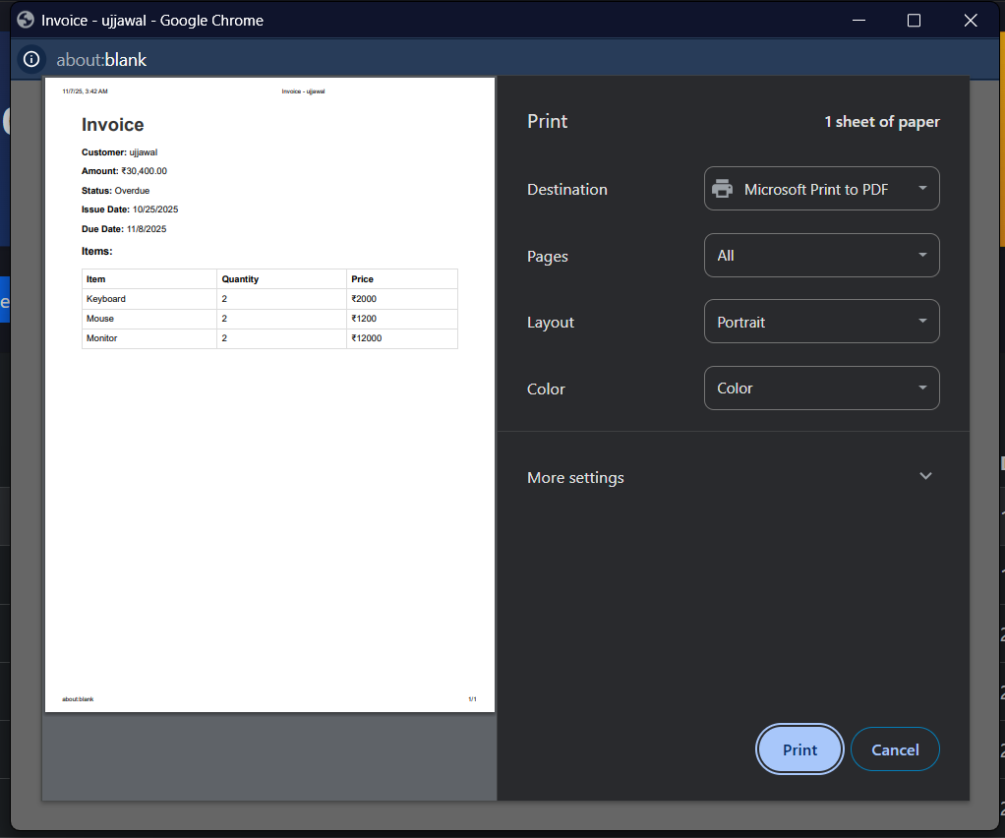
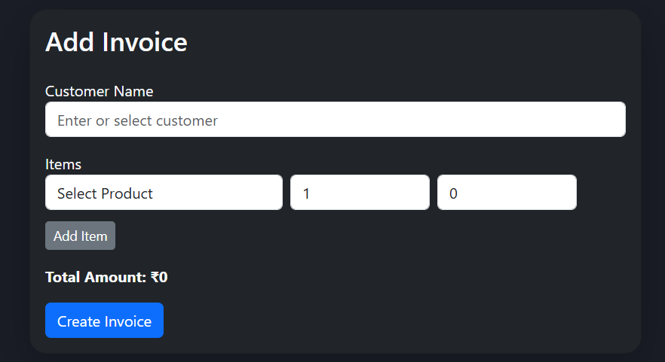
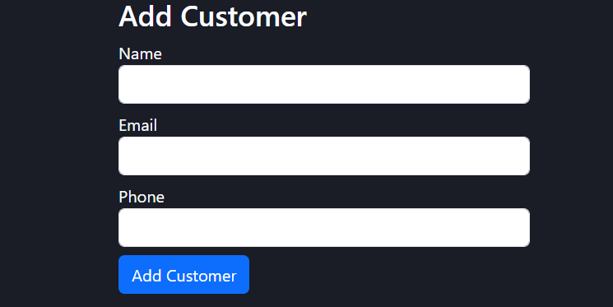
Working Demo

Slide 8

Q/A

